Slide 1

Production of B1 vitamin-rich Rice by Means of Biotechnology for Crop Nutrient Enrichment
Group Members :
Dua Türkmen | 116201071
Şeyma Çorbacı | 116201009
Tuğberk Göç | 115200084
Uğurcan Barut| 113206042
Mısra Şimşir | 115203037
Burak Demirel | 115200034
Group Number : 13
Green Biotechnology | ENGR 438
Instructor : Prof. Dr. Hatice Gülen

Slide 2
Outline
Importance of vitamin B1 for the human body
Importance of vitamin B1 for the plants
Advantages of GM crops
GM crops examples
Vitamin B1-rich rice
Why rice?
Aim of producing vitamin B1-rich rice
Vitamin B1 deficiency
Wet beriberi
Dry beriberi
E. Coli bacterium and vitamin B1 production
Production of GM vitamin B1 rich rice
Ethical concerns about gene manipulation
Golden rice statistics
Conclusion
References

Slide 3
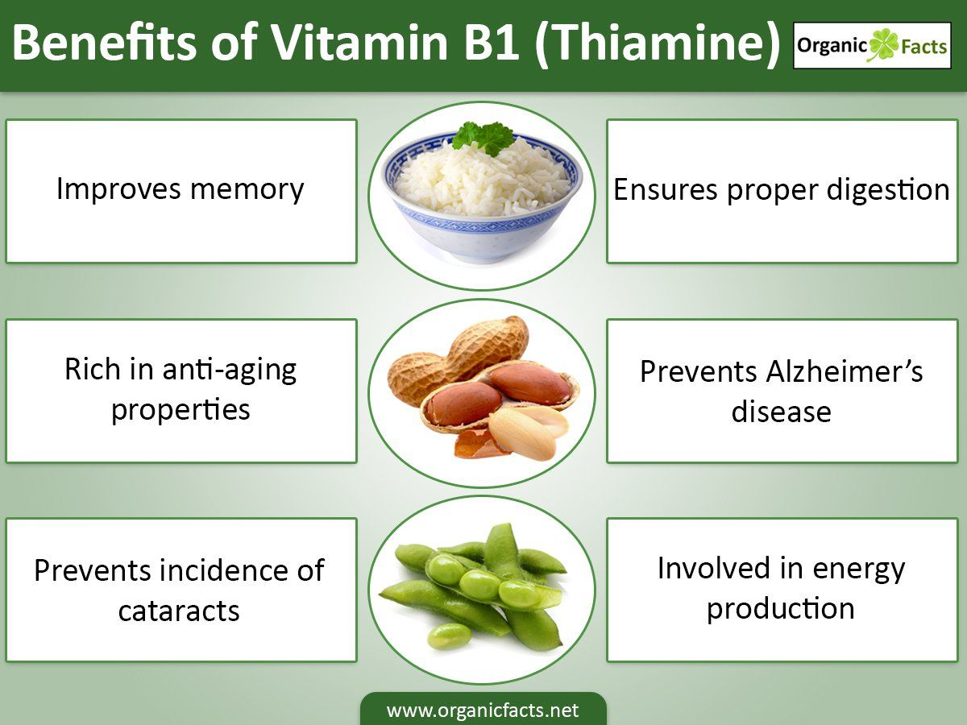
Introduction
Importance of vitamin B1 for the human body
Vitamine B1(Thiamin), helps prevent complications in the nervous system, brain, muscles, heart, stomach, and intestines. It is also involved in the flow of electrolytes into and out of muscle and nerve cells.
Helps prevent diseases such as beriberi
Some athletes use thiamin to help improve their performance.
Necessary for the proper functioning of the digestive system.
May lower the risk of developing cataracts.
Uğurcan Barut

Slide 4
Importance for the plants
Thiamine is known to have its role as a cofactor for important metabolic activities.
An important regulator that plays an important role in which the plant is the primary regulator.
Living organisms require the active form of thiamine, known as thiamine pyrophosphate (TPP) to act as an important cofactor.
TPP is an essential component in many metabolic activities such as acetyl-CoA biosynthesis, amino acid biosynthesis, Krebs cycle and Calvin cycle.
Benefits to plants by stimulating root growth of vitamin B-1 or reducing transplant shock.
Uğurcan Barut

Slide 5
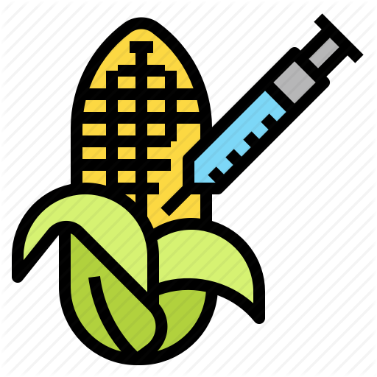
Advantages of GM crops
More tolerant and resistant crops to disease or drought
Lower costs with producing larger amounts
Increased crop yields
More nutritious foods in terms of vitamin and mineral
New products with enhanced quality and taste
More resistant plants to insects
Increase farmers income because of increased efficiency and enhanced productivity
Mısra Şimşir

Slide 6
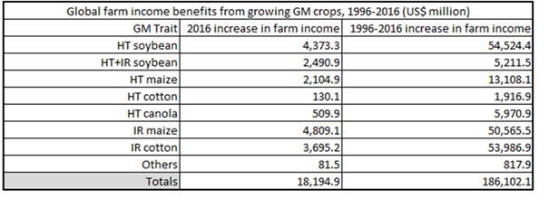
Advantages of GM crops
Farmer’s Income
Mısra Şimşir

Slide 7
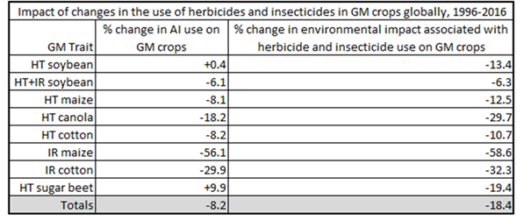
Advantages of GM crops
Pesticide Use
Mısra Şimşir

Slide 8
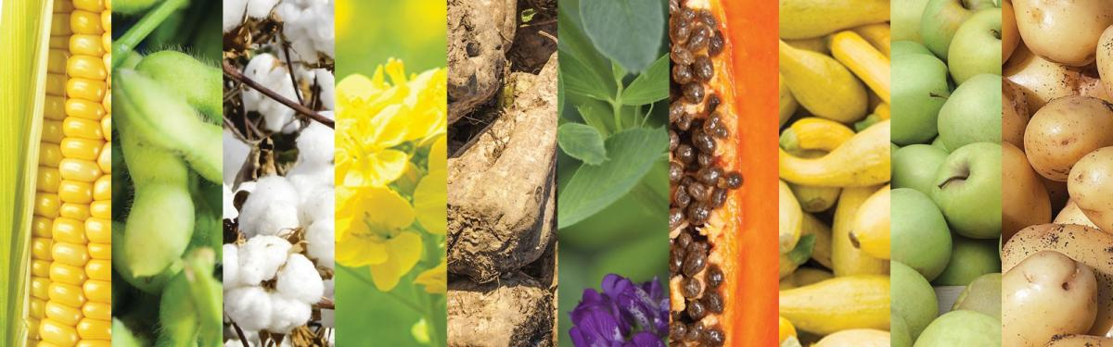
GM crops examples

Slide 9
Vitamin B1-rich Rice
In the case of our GM rice, a specific exogenous gene (ThiM), taken from E.coli bacterium, will be inserted into the DNA of the rice in order to get a new variety rich with vitamin B1.
Dua Türkmen

Slide 10
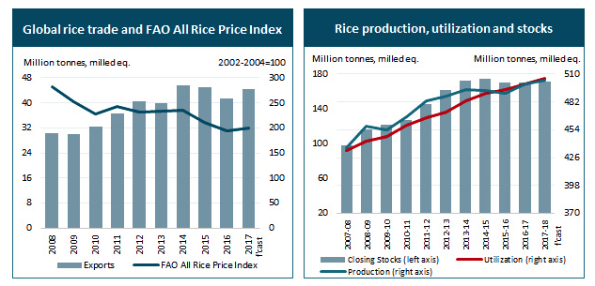
Why Rice?
Rice is one of the most important and leading food crop in the world. Enhancing the production of such kind of food would be helpful to meet the demands of massively increasing population. for example, in 2012, approximately half of the world’s population (three billion people) depended on the rice as a main food source.
Dua Türkmen
Figure: Global rice trade, production, utilization and stocks.

Slide 11
Rice can be grown in a different range of locations under unique climatic conditions, which makes it suitable and easily adopted by different countries around the world.
Optimum factors of rice cultivation:
Temperature: average between 20°C and 27°C.
Rainfall: average annual rainfall between 175—300 cm.
Soil: Fertile riverine alluvial soil.
Fertilizers: three essential nutrients are required which are nitrogen, phosphorus and potassium.
Dua Türkmen

Slide 12
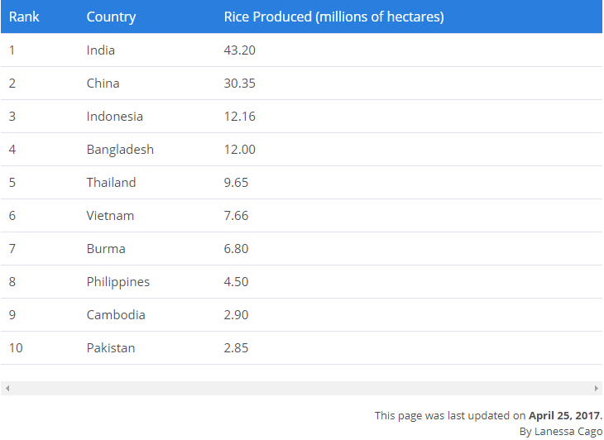
Figure: Top rice producing countries around the world.
Dua Türkmen

Slide 13
Aims of Producing vitamin B1-rich Rice
Beef and fish meats are some main sources of vitamin B1. People who live under the poverty line may not be able to afford such kind of food, however, rice is a good kind of food and meanwhile affordable one.
Vitamin B1 is a water-soluble vitamin that’s secreted outside the body via urine and human bodies are not able to synthesize it by themselves, therefore, it must be supplied daily via their dietary[3].
Vitamin B1 benefits are not just limited to human being! It plays an important role in plant resistance against abiotic and biotic stresses and therefore enhancing their growth, development and productivity.
Dua Türkmen

Slide 14
Vitamin B1 deficiency
Vitamin B1 deficiency is considered as a medical condition of low thiamine levels.
Thiamine deficiency can be caused by different factors:
Poor intake
Poor absorption
Increased loss of thiamine
Increased thiamine utilization such as in the case of pregnancy
Beriberi is a severe and chronic form of vitamin B1 deficiency, with to major types:
Wet beriberi
Dry beriberi [2]
Şeyma Çorbacı

Slide 15
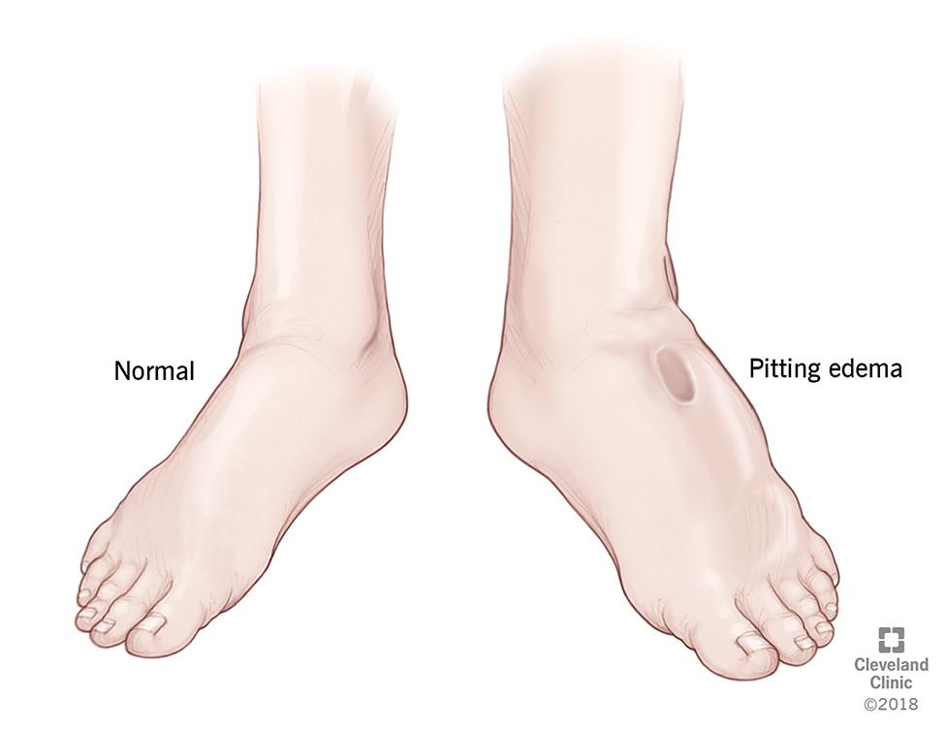
Wet beriberi
It affects the cardiovascular and the circulatory system.
It causes:
Failure of heart function.
Shortness of breath.
leg swelling [2]
Figure: leg swelling.
Şeyma Çorbacı

Slide 16
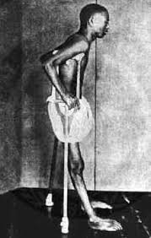
II. Dry beriberi
It affects the nervous system of the patient.
It causes:
Difficulty in walking
Loss of sense in hands and legs
Mental confusion
Difficulty to speak
Pain [2]
Şeyma Çorbacı
Figure: Beriberi symptoms.

Slide 17
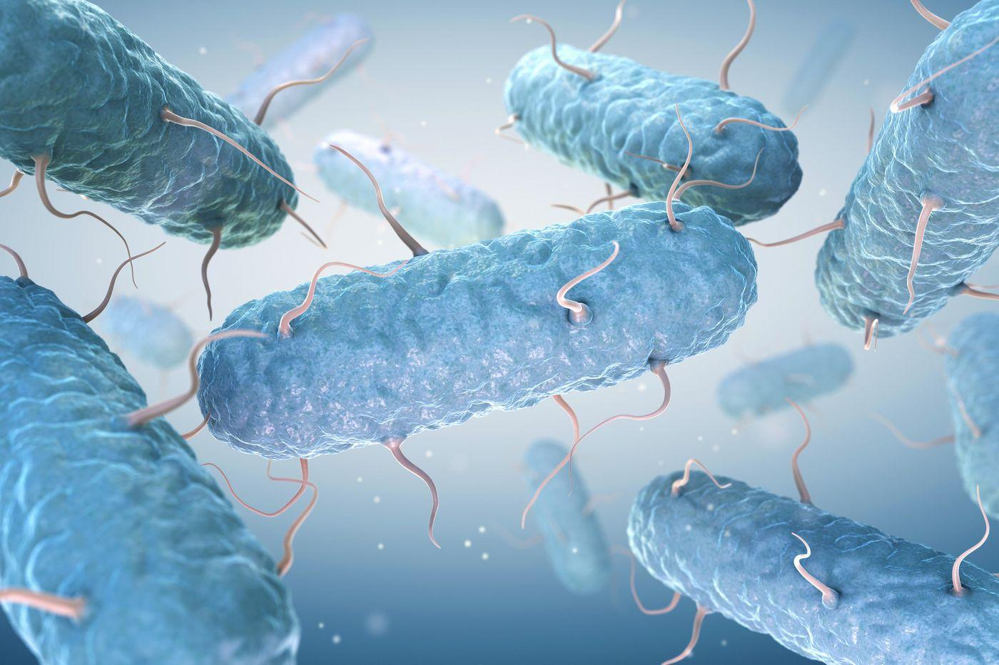
E.coli bacterium and vitamin B1 production
E. coli is a type of bacteria that live in animal and human bodies.
It has 3000 genes. Among these genes is the ThiM gene, which is responsible for the production of thiamine ( vitamin B1 ) [4].
Reasons of choosing E. coli :
Simple to handle and well-understood.
Ability to produce high levels of the desired product.
Having a similar pathway of thiamine synthesis with plants.
Very widely used in genetic engineering [5].
Figure 5: E. coli bacteria [5].
Şeyma Çorbacı

Slide 18
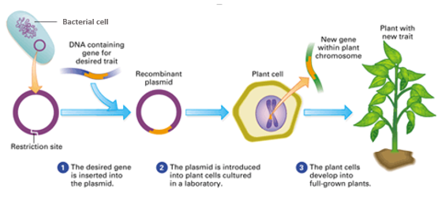
Production of GM vitamin B1-rich rice
Isolation of ThiM gene from E. coli.
Insertion of desired gene into a plasmid ( vector used to transfer DNA ).
Introducing the ThiM gene containing bacterial cells into rice plant cells.
Selection and regeneration of ThiM gene containing plant cells [6].
Figure 6: Transfer of ThiM gene into rice plant cell [7].
Şeyma Çorbacı

Slide 19
Ethical Concerns About Gene Manipulation
Whether GMO products are necessary or not
The quantity and quality of products produced through bioengineering increase. For example, if pre-bioengineering production is 60 percent in a field, the amount can increase up to 80 percent with GMOs. The question ethically asked here is whether it is useful to use these products to reduce hunger rates in the world. It is certain that more production will be needed to feed the growing population in the world.
Mısra Şimşir

Slide 20
Ethical Concerns About Gene Manipulation
2. Violation of Human Rights
Violation of the consumer right to choose because GMO products can not be separated from their natural counterparts.
Violation of religious rights because some belief groups want to avoid fruits and vegetables with insects, animals genes.
Vegetarians can oppose fruits and vegetables that contain animal genes.
Mısra Şimşir

Slide 21
Why we have chosen rice instead of others
We are going to be showing them as two parts which are supported by evidences.
Comparison of Rice, Bulgur and Barley
Statistics 01 - Rice Production and Consumption
Statistics 02 - Barley Production and Consumption
Statistics 03 - Wheat Production and Consumption
Golden Rice Statistics in Asia-Pacific Region Countries
Tuğberk Göç - Burak Demirel

Slide 22
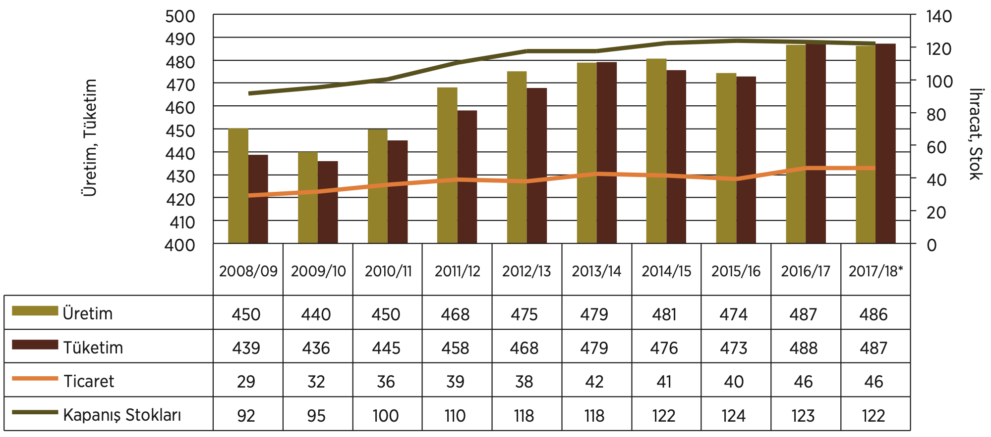
Statistics 01
Tuğberk Göç - Burak Demirel
Figure 7: World Rice Balance Graph (million tons) [13]
According to TMO (Toprak Mahsülleri Ofisi), rice production and consumption represents really huge number all around the world.

Slide 23
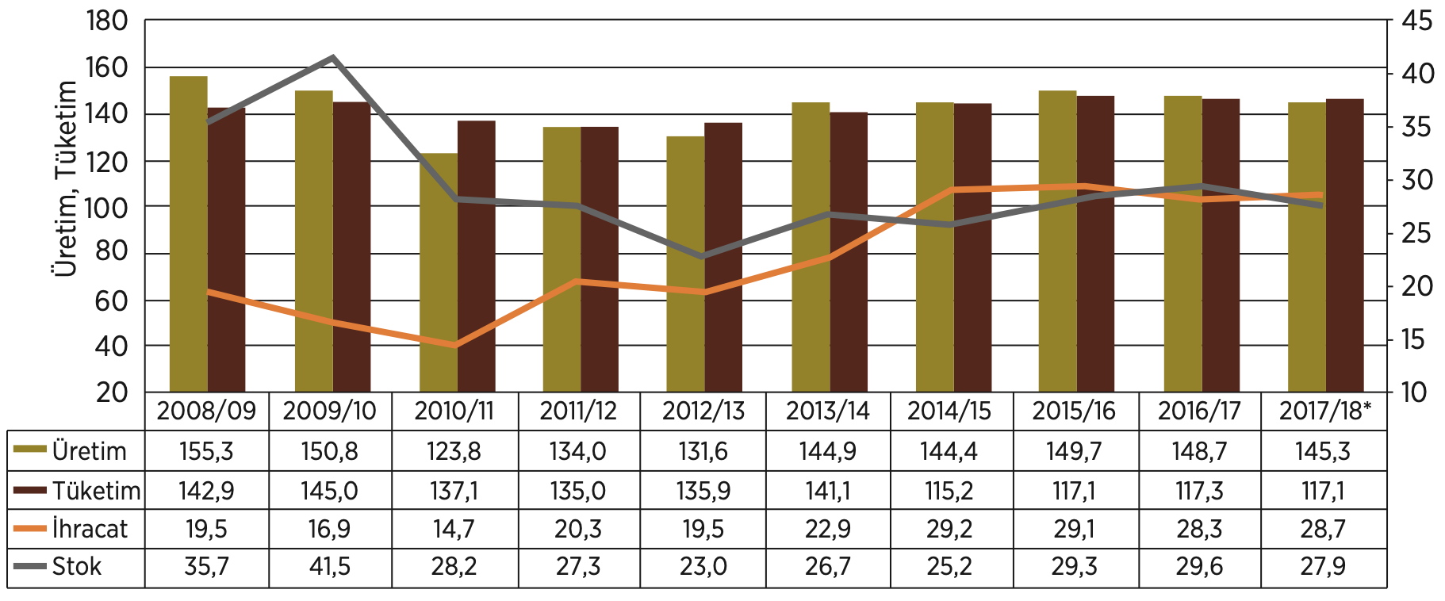
Statistics 02
Tuğberk Göç - Burak Demirel
Figure 8: World Barley Balance Graph (million tons) [13]
According to TMO (Toprak Mahsülleri Ofisi), barley production and consumption represents also really huge number. However, in comparison with rice, it is clearly seen that the number of Rice production and consumption is higher than Barley.

Slide 24
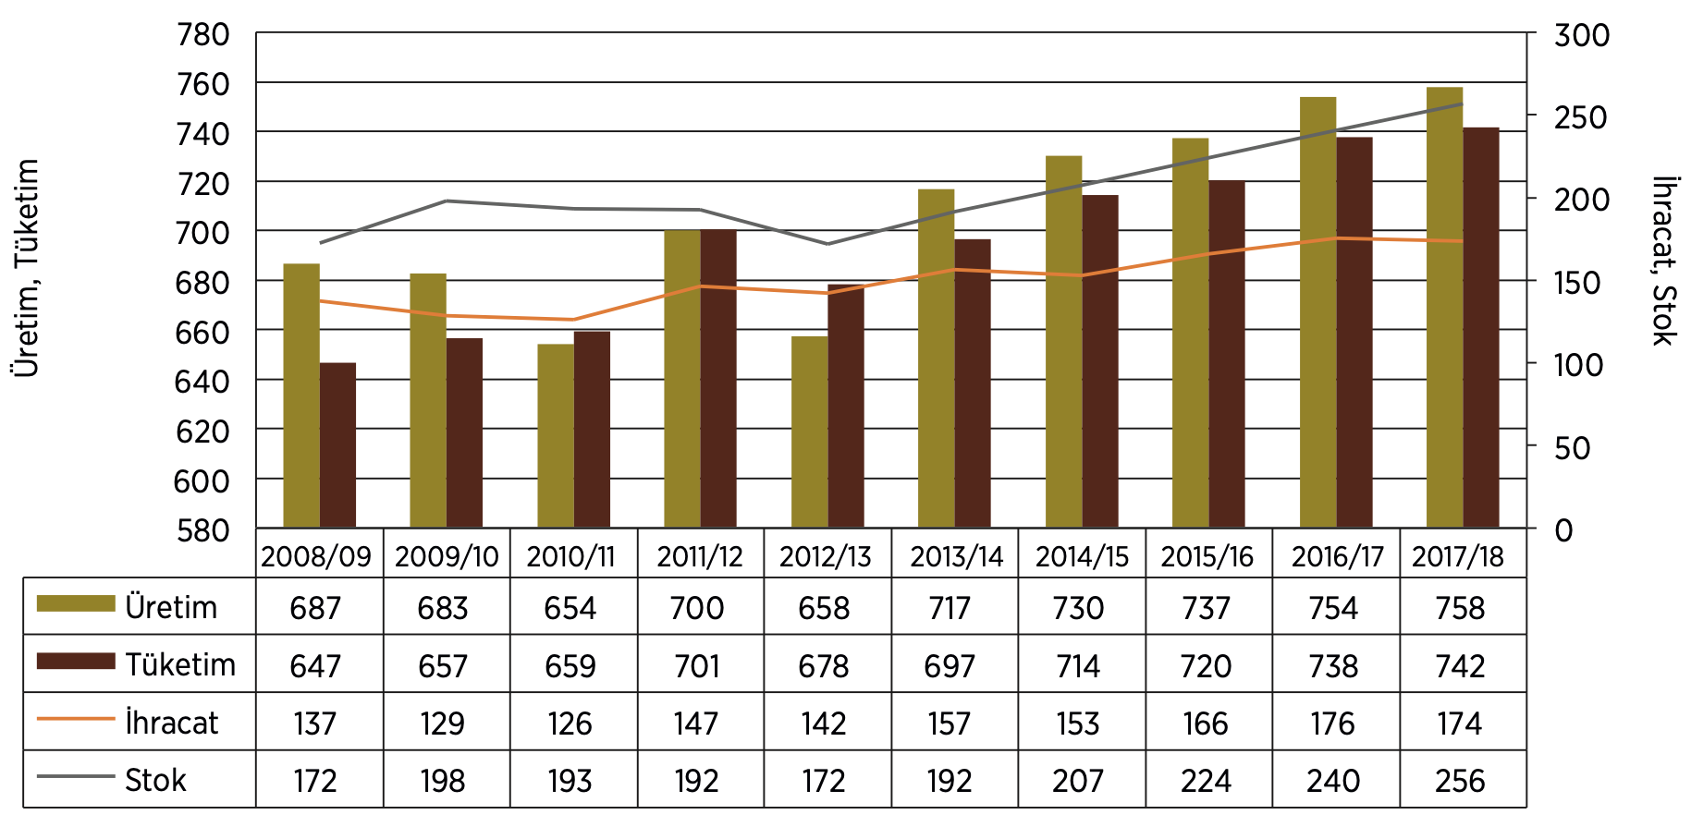
Statistics 03
Tuğberk Göç - Burak Demirel
According to TMO (Toprak Mahsülleri Ofisi), wheat production and consumption is higher than others. But, our comparison has to be with bulgur which is a type of wheat. Thus, these values are decreased because of different varieties. Our assumption rice production and consumption is going to be bigger than bulgur production and consumption.
Figure 9: World Wheat Balance Graph (million tons) [13]

Slide 25
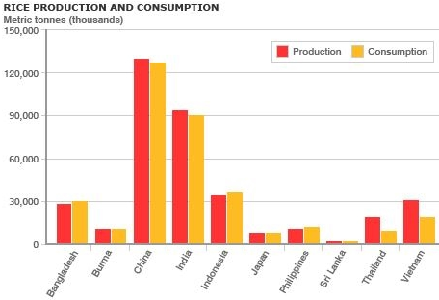
Golden Rice Statistics
Figure 10: Rice Production and Consumption (Introduction - Sustainability of Rice Production 2020) [8].
More than 90 percent of the world’s rice is created and expended in the Asia-Pacific Region. With developing prosperity, per capita rice consumption has begun to decrease in the middle and high income Asian countries but among the poor Asian population rice consumption has developed. Since 1950 the growth rate for rice consumption has kept pace with the demand through increases in yield rather than increases in expansion of farmland. The world rice supply has gone from 261 million tonnes in 1950 to 573 million tonnes in 1997 (Papademetriou, 2000). A measure of this achievement is reflected by the fall in the cost of rice on the planet markets.
Tuğberk Göç - Burak Demirel

Slide 26
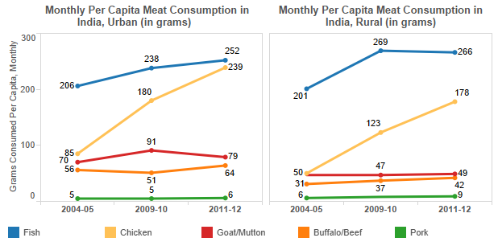
Solution for countries which are don’t eat meat
Poor countries cannot eat meat enough in order to move their life. They eat rice rather than meat. Thus, People don’t meet their vitamin B need.
Indians don’t eat some kind of meats because of their religion belief. However, they consume rice instead.
Golden rice can be reach in every countries and people can take vitamin B1.
Figure 11: India Meat Consumption (Chandra 2020) [9].
Tuğberk Göç - Burak Demirel

Slide 27
Conclusion
According to our solutions, human beings might think that this product of B1 vitamin-rich rice is essential to move on our life as a healthy person to overcome some diseases which can even cause death. Also, it is easy to reach from everyone else in terms of price, production and so on comparing to others which are wheat and bulgur. Thus, in order to meet our vitamin needs, this product will help a lot, especially in selected countries which we have mentioned before as Asia-Pacific Region countries.
Tuğberk Göç - Burak Demirel

Slide 28
References
[1]:(n.d.) Retrieved from https://www.isaaa.org/resources/publications/pocketk/5/default.asp
[2]: Wiley, K. D. (2019, December 29). Vitamin B1 Thiamine Deficiency (Beriberi). Retrieved from https://www.ncbi.nlm.nih.gov/books/NBK537204/
[3]: (n.d.). Retrieved April 6, 2020, from https://www.dietobio.com/vegetarisme/en/vit_b1.html
[4]: E. coli – the biotech bacterium. (n.d.). Retrieved from https://www.sciencelearn.org.nz/resources/1899-e-coli-the-biotech-bacterium
[5]: McCullough, M. (2019, November 25). E. coli: What you need to know. Retrieved from https://www.inquirer.com/health/ecoli-explained-outbreak-romaine-fda-cdc-20191125.html

Slide 29
References
[6]: National Research Council (US) Board on Agriculture. (1984, January 1). Gene Transfer. Retrieved from https://www.ncbi.nlm.nih.gov/books/NBK216398/
[7]: (n.d.). Retrieved from https://bodell.mtchs.org/OnlineBio/BIOCD/text/chapter13/concept13.3.html
[8]: Introduction - Sustainability of Rice Production (2020) Introduction - Sustainability of Rice Production [online] available from <https://sites.google.com/a/cornell.edu/bee3299_sustainability-of-rice-production/board-minutes> [7 April 2020]
[9]: Chandra, R. (2020) Read at Home: How This Venture Capital Company Missed the Chance to Invest in BookMyShow [online] available from <https://scroll.in/article/958323/read-at-home-how-this-venture-capital-company-missed-the-chance-to-invest-in-bookmyshow> [7 April 2020]

Slide 30
References
[10]: TMO (2017b) Hububat Raporu [online] available from <http://www.tmo.gov.tr/Upload/Document/hububat/HububatRaporu2017.pdf>
[11]:Subki, A., Abidin, A. A. Z., Norhana, Z., & Yusof, B. (2018, September 26). The Role of Thiamine in Plants and Current Perspectives in Crop Improvement. Retrieved from https://www.intechopen.com/books/b-group-vitamins-current-uses-and-perspectives/the-role-of-thiamine-in-plants-and-current-perspectives-in-crop-improvement
[12]:https://blog.daveasprey.com/sulbutiamine-nootropic-benefits/
‌

